Slide 1
Term project
D a t a S c i e n c e
Team 5
201033093 고준호
201533636 김승호
201834707 김민걸
201937913 박예진

Slide 2
100%
Objective setting
Purpose of Data Analysis
01
Data Inspection
04
Analysis Algorithms
Describe and visualize
Data exploration
02
K-means-cluster
Logistic regression
Decision tree
KNN
TABLE OF
CONTENTS
Data Preprocessing
03
Value change
Feature engineering
05
Evaluation
K-fold cross
Team role
06
Task assignment for each member

Slide 3
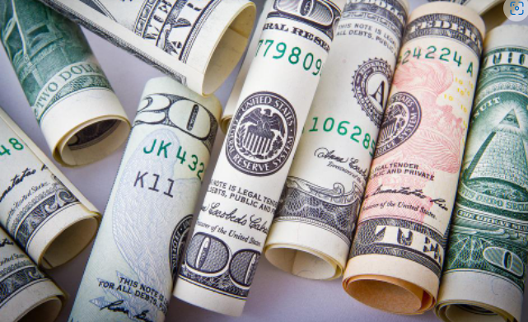
100%
Objective setting
Income
Target
The income dataset is a dataset
representing income for various topics
In Kaggle.
There is an item called 'target' in the
column, which has a binary value.
A value of 0 means that you have an
income of less than $500,000,

Slide 4
100%
Objective setting
Object
Find best
feature combination
Using
Functionalized
Data Analysis Algorithm
Simply, Neatly, Visualization, Functionalization .
Many features
Target
$500,000
The purpose of the program is to predict the target(=income) by clustering each value with a given column
(age, work class, education level, marital status, occupation, family relations, race, sex, hours.per.week, and nationality). It is also the purpose of the program to find the column most related to income.

Slide 5
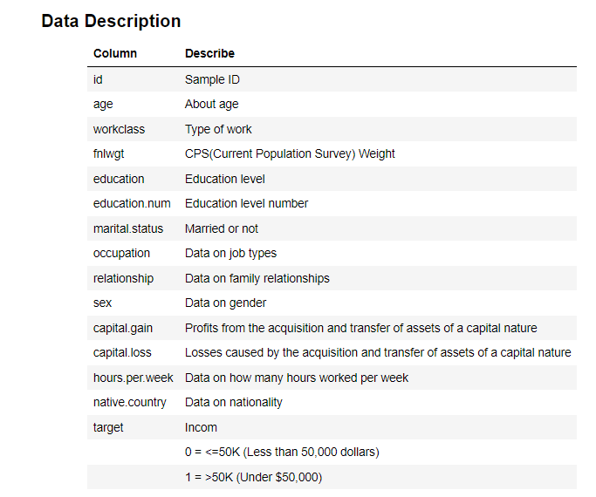
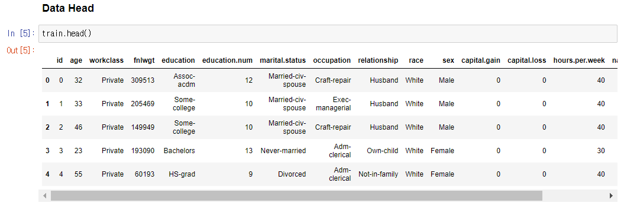
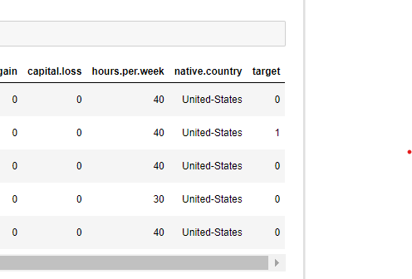
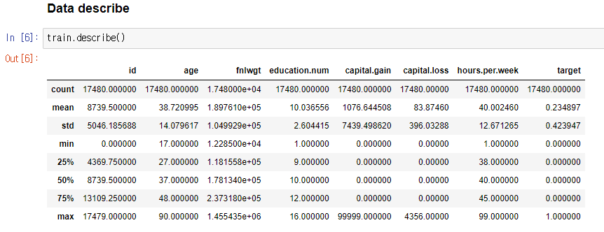
100%
Data Inspection

Slide 6
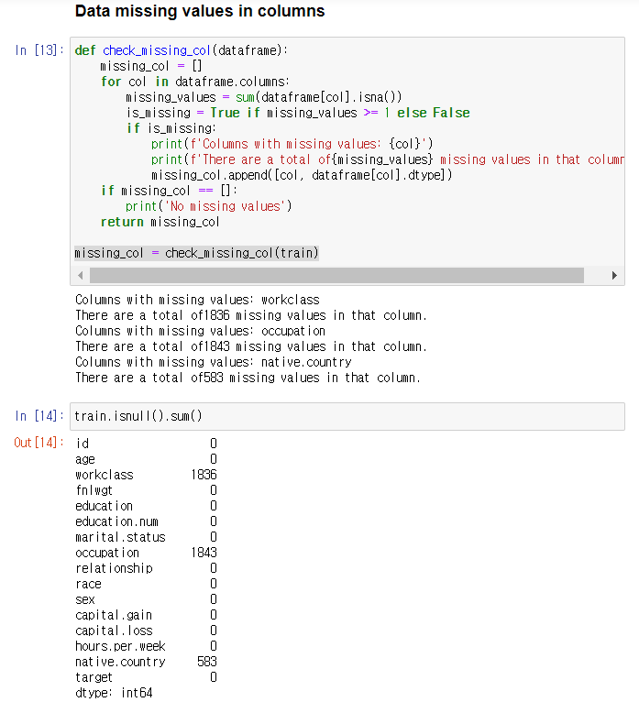
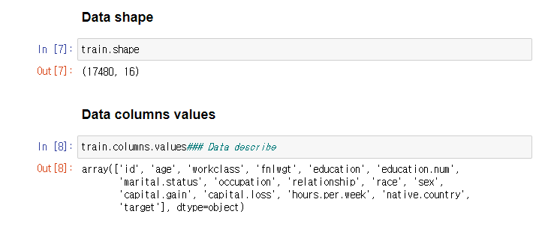
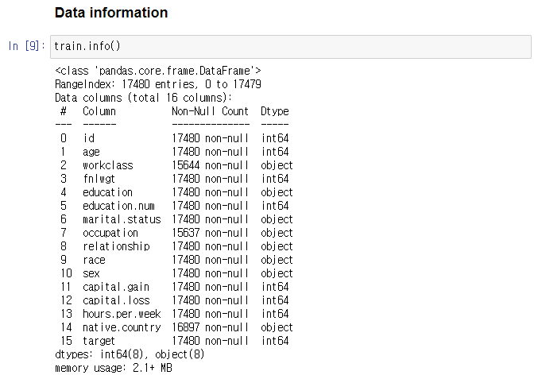
100%
Data Inspection
All the features of having missing data are category features

Slide 7
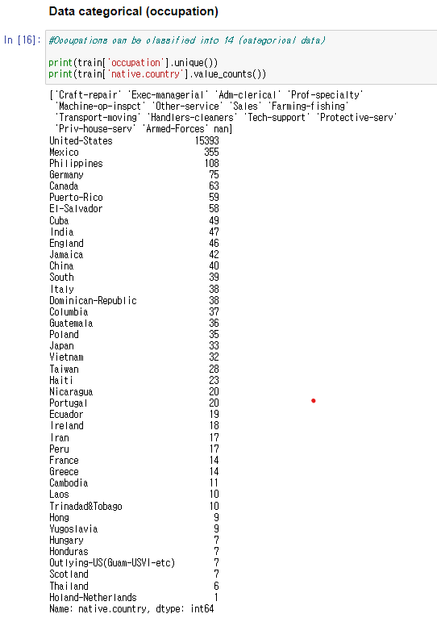
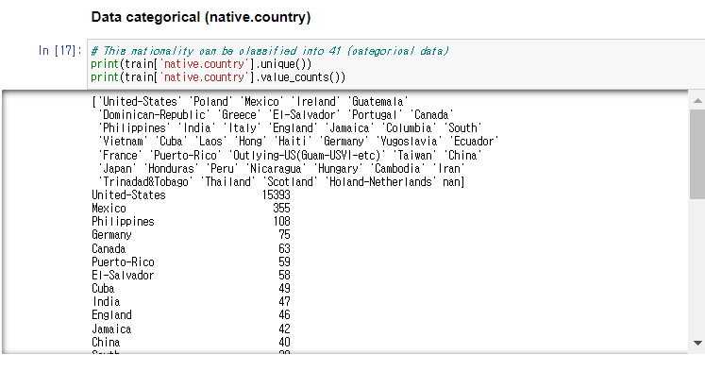
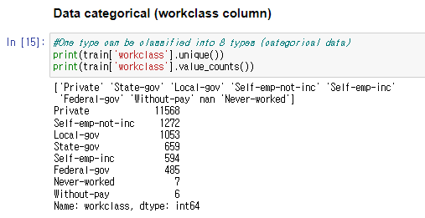
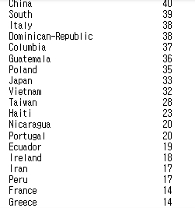
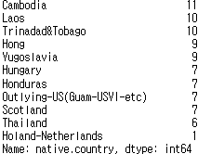
100%
Data Inspection

Slide 8
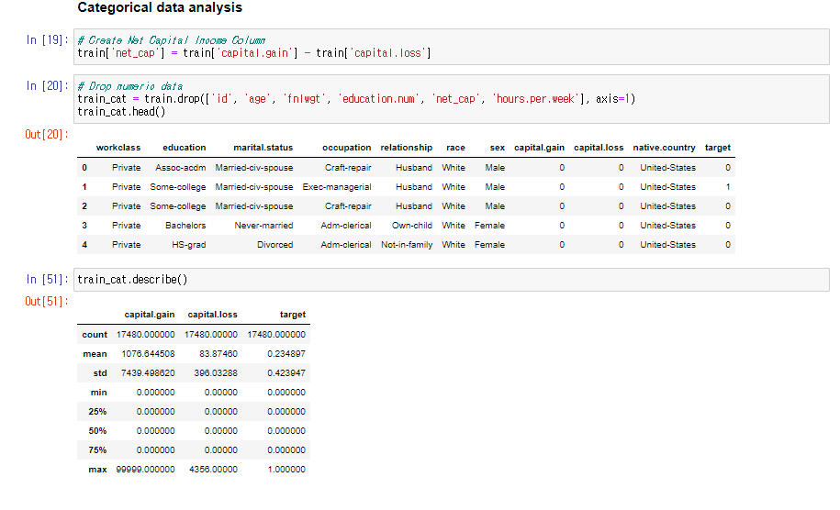
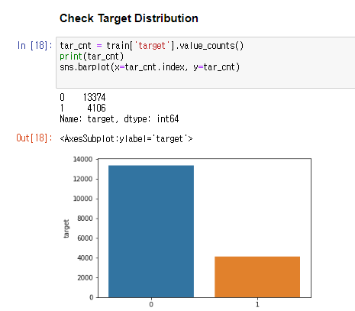
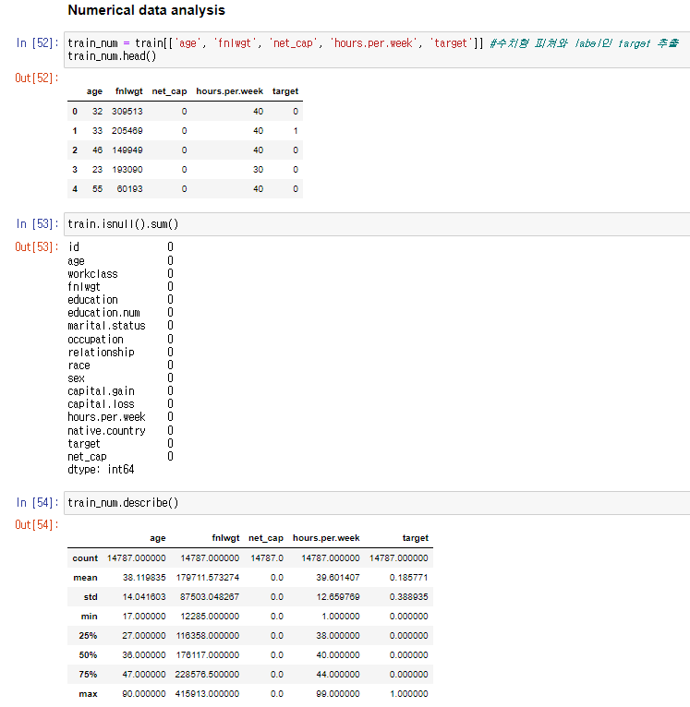
100%
Data Inspection
Distribution of ‘Target’ analyzed
So, we use classification,
Logistic regression

Slide 9
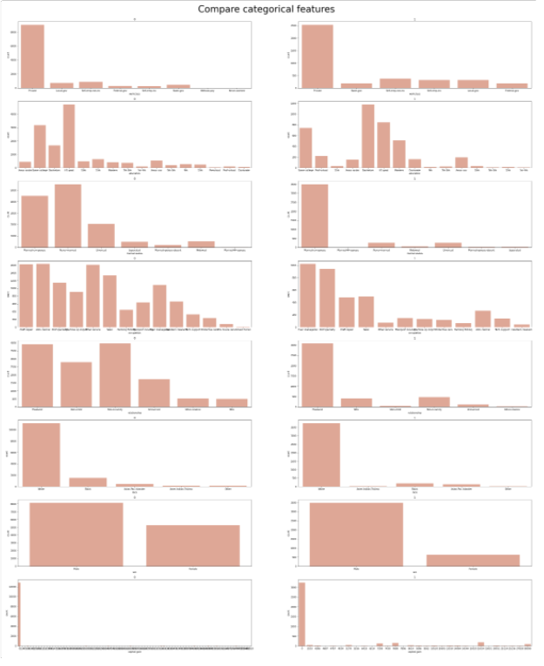
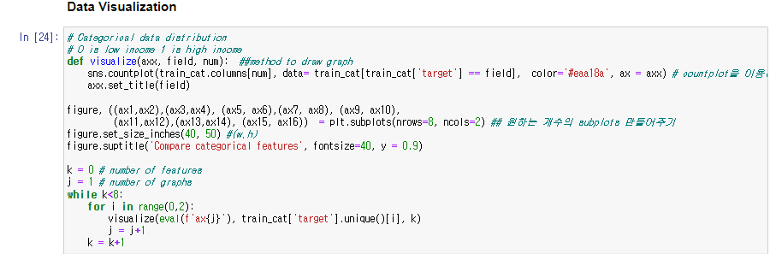
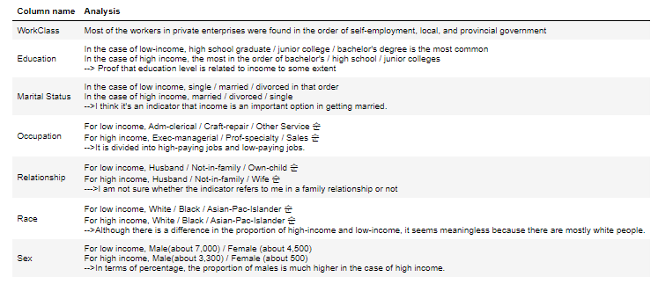
100%
Data Inspection

Slide 10
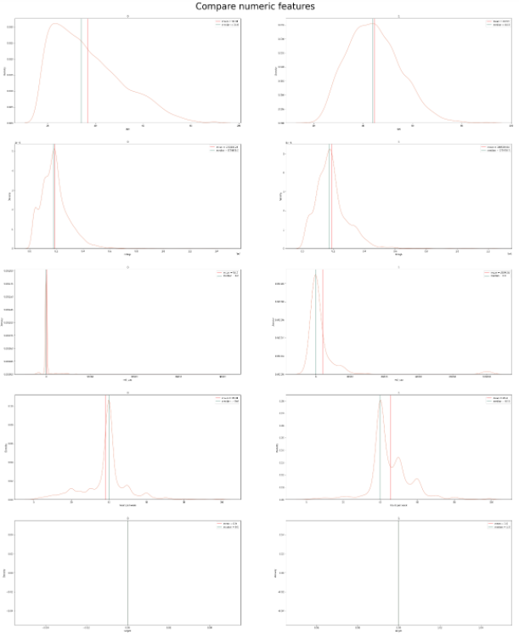
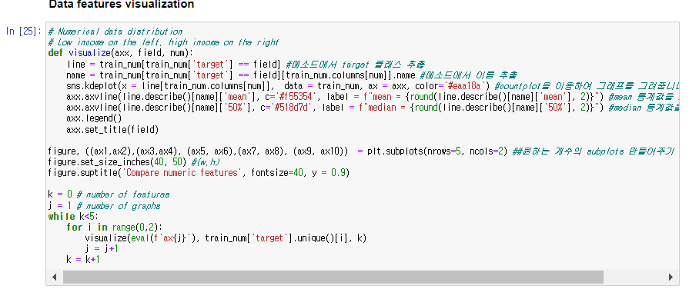
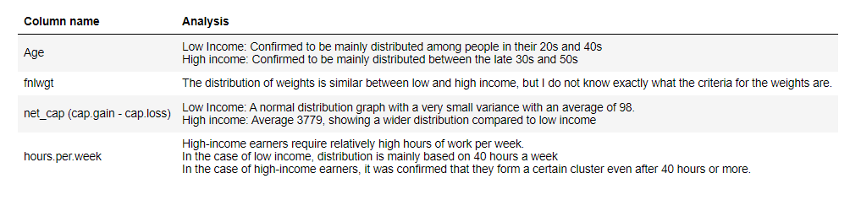
100%
Data Inspection

Slide 11
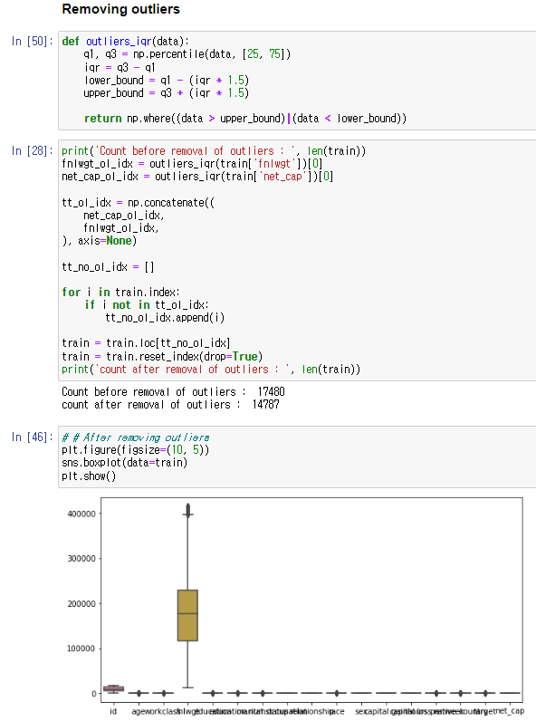
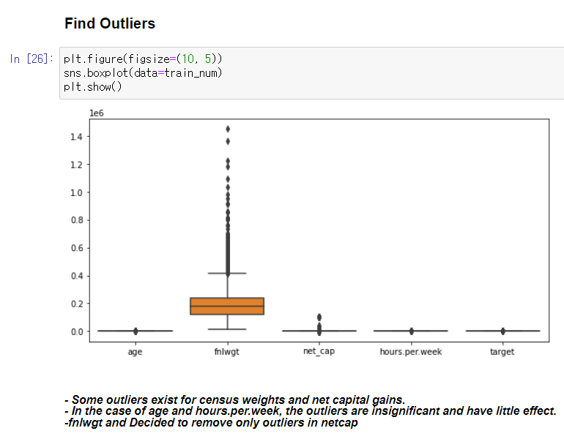
100%
Data Preprocessing value change

Slide 12
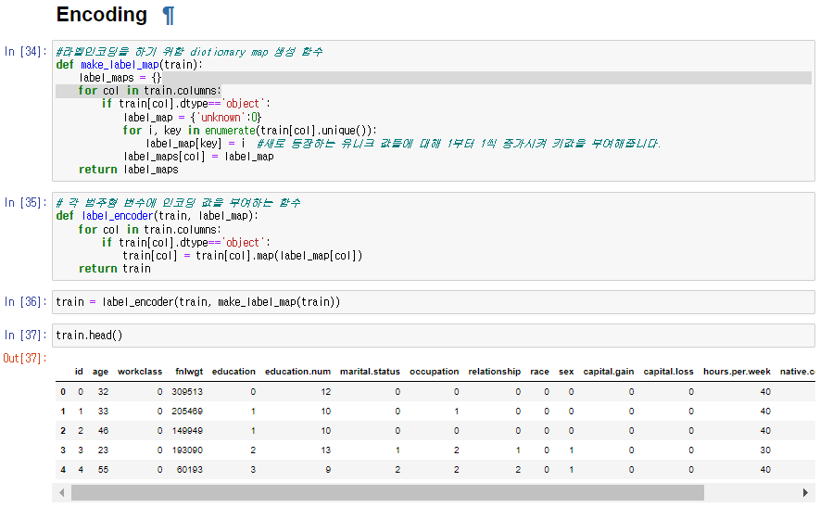
100%
Data Preprocessing value change
All the features of having missing data are category features
Randomly assign a number to the value of the category, starting from zero
When a new value comes out, +1
Therefore, processing missing data automatically

Slide 13
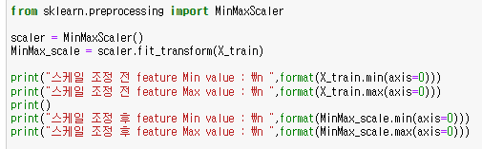
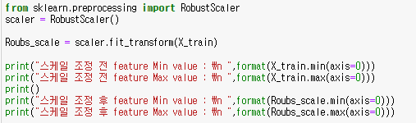
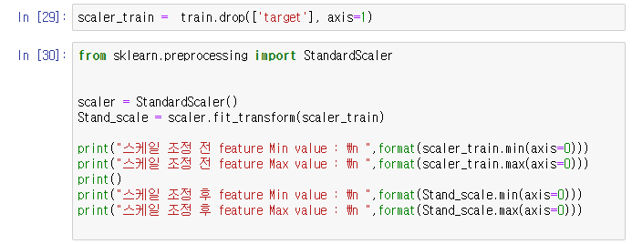
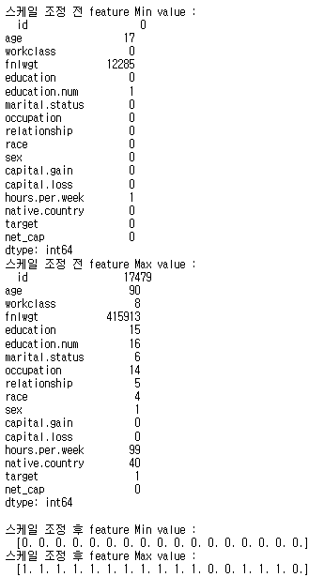
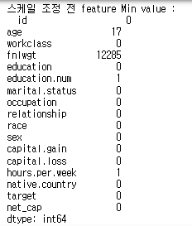
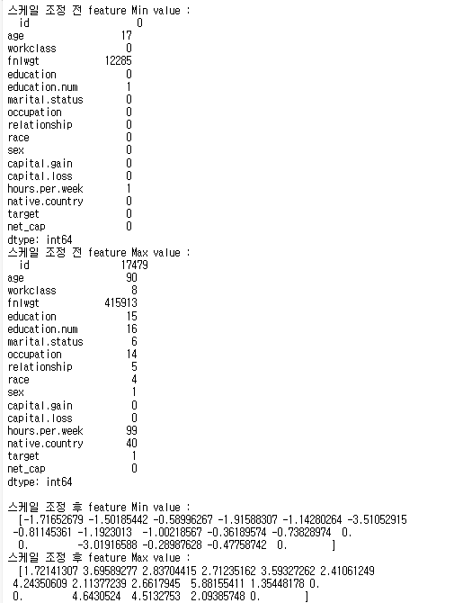
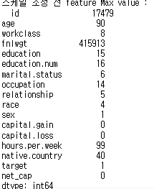
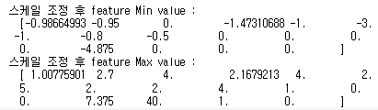
100%
Data Preprocessing Feature engineering(Scaling)
Standard scaler
MinMax scaler
Robust scaler

Slide 14
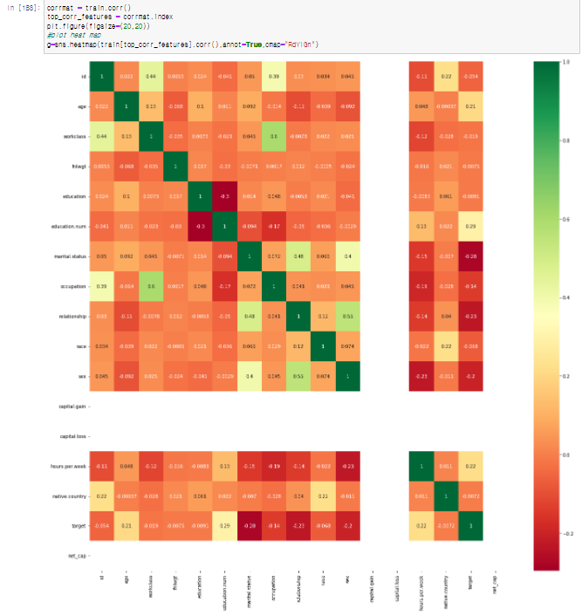
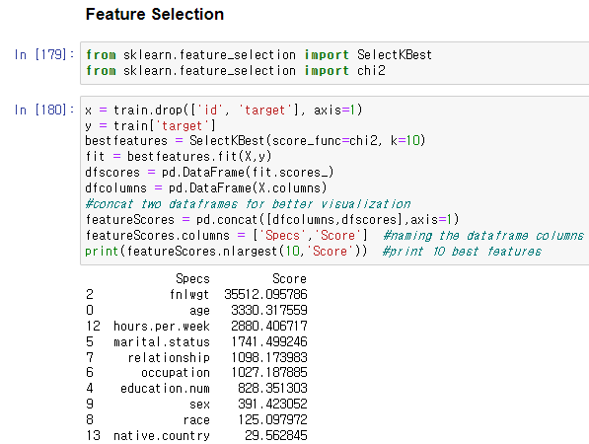
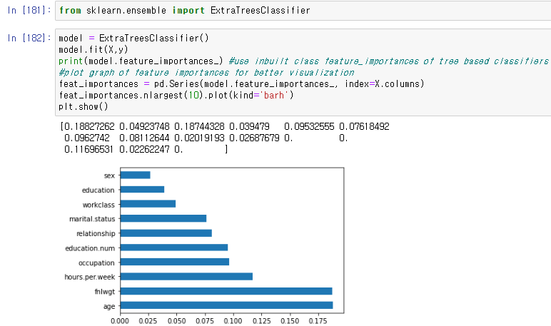
100%
Analysis Algorithms
K-Means-Clustering
Best
1. age
2. Fnlwgt
-> Excluding evaluation index values because they are too small
3. hours.per.week
Find the most relevant features
to target in order to measure

Slide 15
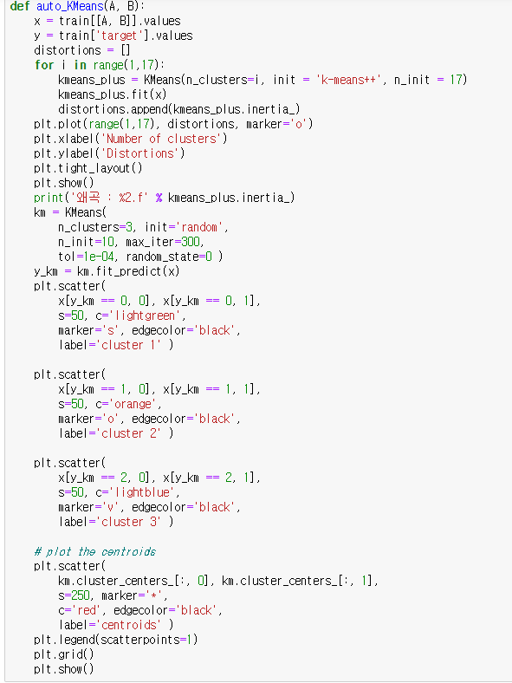
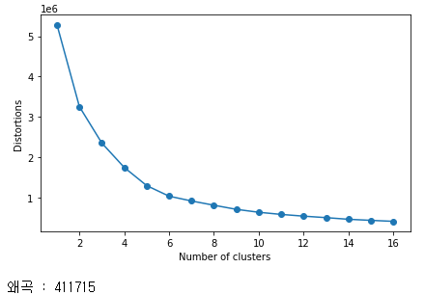
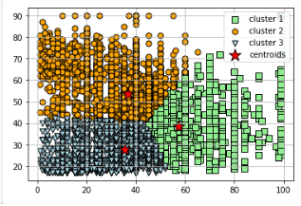
100%
Analysis Algorithms
K-Means-Clustering
The most distorted part is 3
Best
A total of three clusters
-Blue : Age 20~30, Hours 30
-Yellow : Age 50~60, Hours 30
-Green : Age 40, Hours 50
Best combination
-> age + hours.per.week
Function name: auto_KMeans
Function parameter : ‘columnA’, ‘columnB’
A function that automatically
Calculation k means clustering

Slide 16
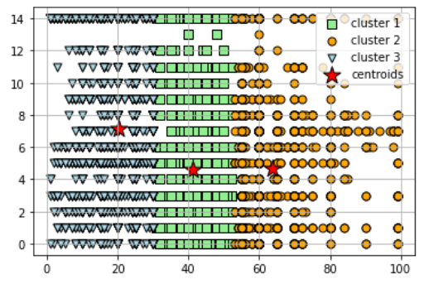
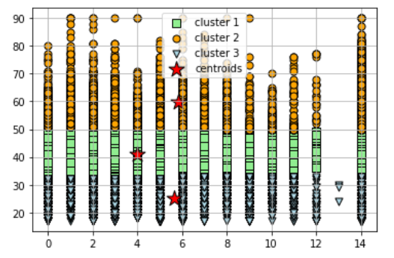
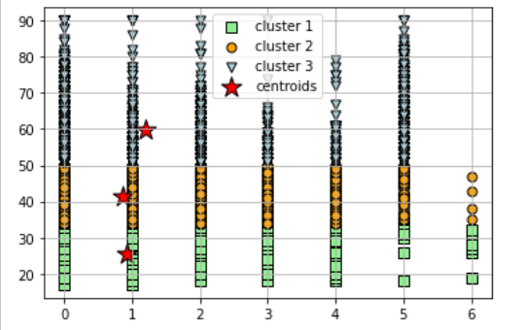
marital.status
100%
Analysis Algorithms
K-Means-Clustering
A total of three clusters
-Blue : occupation 0~30, Hours 7
-Yellow : occupation 30~50, Hours 4
-Green : occupation 50, Hours 4.5
A total of three clusters
-Blue : Age 20~30, occupation 5
-Yellow : Age 30~50, occupation 4
-Green : Age 50~, occupation 5.1
A total of three clusters
-Blue : Age 20~30, marital.status 1
-Yellow : Age 40~50, marital.status 0.9
-Green : Age 40, marital.status 1.3
X: occupation
Y: hours.per.week
X: age
Y: occupation
X: age
Y: marital.status

Slide 17

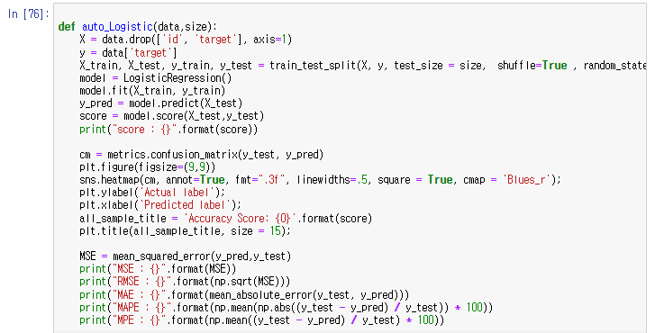
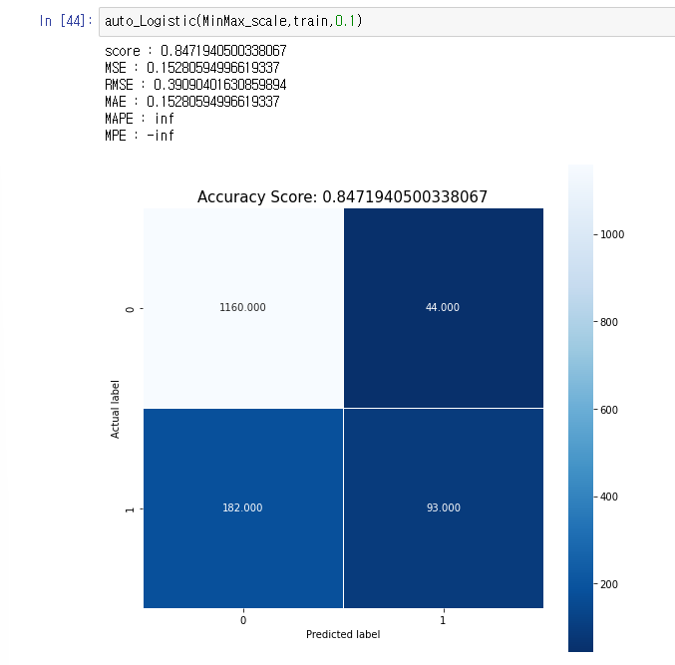
100%
Analysis Algorithms
Logistic Regression
Best
Standard, 0.1 -> 84.4
Standard, 0.5 -> 84.2
Standard, 0.8 -> 84.2
MinMax 0.1 -> 84.7
MinMax 0.5 -> 84.2
MinMax 0.8 -> 84.2
Robust 0.1 -> 84.4
Robust 0.5 ->84.2
Robust 0.8 -> 84.2
Best combination
-> test_size = 0.1
-> MinMax scaler
Function name: auto_Logistic
Function parameter : data, test_size
A function that automatically
Calculation score & MSE & MAE & MPE & MAPE

Slide 18
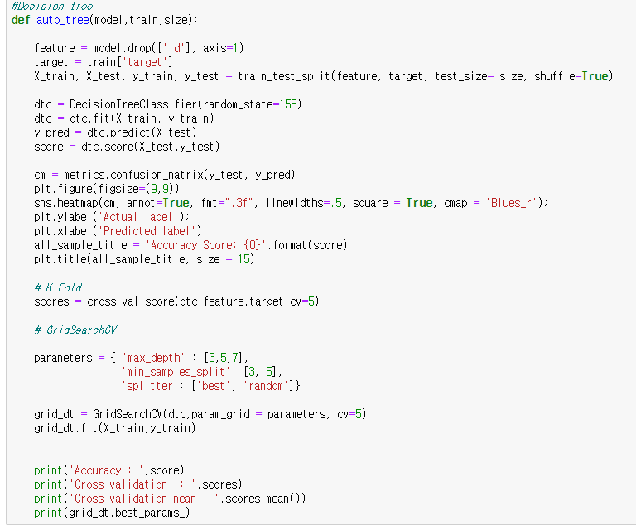
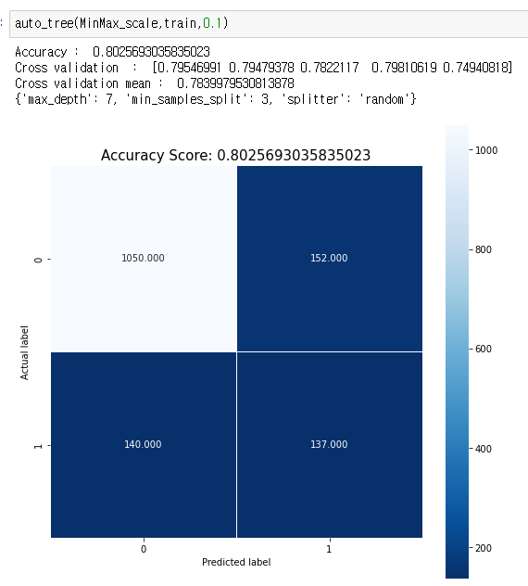
100%
Analysis Algorithms
GridSearchCV-Decision tree
Best
Standard, 0.1 -> 79.3
Standard, 0.5 -> 79.4
Standard, 0.8 -> 79.0
MinMax 0.1 -> 80.2
MinMax 0.5 -> 80.1
MinMax 0.8 -> 79.2
Robust 0.1 -> 78.5
Robust 0.5 ->79.5
Robust 0.8 -> 79.6
Best combination
-> test_size = 0.1
-> MinMax scaler
Function name: auto_tree
Function parameter : data, test_size
A function that automatically
Calculation parameter and decision tree score

Slide 19
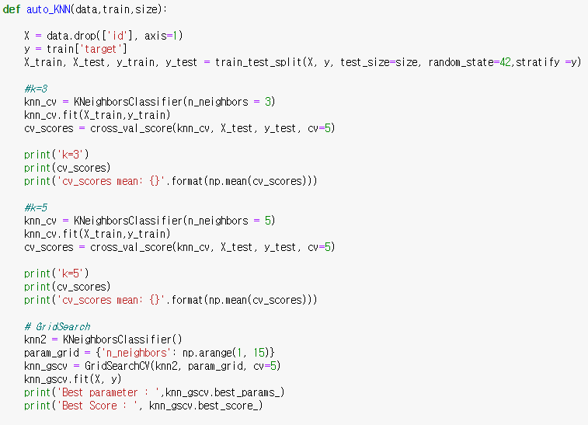
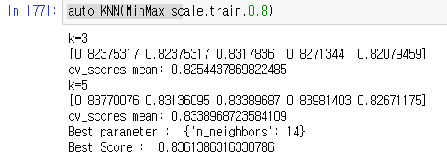
100%
Analysis Algorithms
GridSearchCV-KNN
K = 3
K = 5
Standard, 0.1 -> 82.4
Standard, 0.5 -> 82.7
Standard, 0.8 -> 82.9
MinMax 0.1 -> 81.5
MinMax 0.5 -> 82.5
MinMax 0.8 -> 82.5
Robust 0.1 -> 81.2
Robust 0.5 ->82.6
Robust 0.8 -> 82.5
Standard, 0.1 -> 83.2 , k = 12
Standard, 0.5 -> 83.4 , k = 12
Standard, 0.8 -> 83.0 , k = 12
MinMax 0.1 -> 82.6 , k = 14
MinMax 0.5 -> 83.1 , k = 14
MinMax 0.8 -> 83.38 , k = 14
Robust 0.1 -> 83.0 , k = 12
Robust 0.5 ->83.0, k = 12
Robust 0.8 -> 83.30 , k = 12
Best
Best combination
-> test_size = 0.1
-> MinMax scaler
-> k =14
Function name: auto_KNN
Function parameter : data, test_size
A function that automatically
Calculation parameter and KNN score

Slide 20
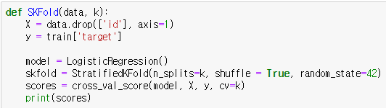
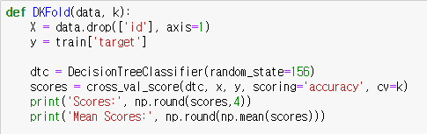
100%
Evaluation
K-fold-cross
Function name: SKFold
Function parameter: dataFrame, k
Following gridSearchCV select k,
A function that automatically calculate score as model
Using stratifiedKFold
Final
Evaluation of data
that was best combination
Function name: DKFold
Function parameter: dataFrame, k
Following gridSearchCV select k,
A function that automatically calculate score as model
Using decisionTree
Notes:
K바꿔야함

Slide 21


100%
Find Best 5 combination
Evaluation
Decision tree
StratifiedKFold

Slide 22

100%
Find Best 5 combination
K-Means-Clustering
Logistic regression
Decision tree
Best combination
-> age + hours.per.week
Best combination
-> test_size = 0.1
-> MinMax scaler
Best combination
-> test_size = 0.1
-> MinMax scaler
KNN (k = 3)
KNN (k = 5)
Best combination
-> test_size = 0.8
-> Standard scaler
Best combination
-> test_size = 0.1
-> MinMax scaler
-> k =14

Slide 23

100%
What I learned
Clustering
As we used the K-means Clustering , we learned the parameters and algorithms necessary for it.
Kaggle
we got a lot of experience by receiving data through the kaggle and using various information from the kaggle
Clustering
Kaggle
Combination
By functioning and combining all of these, we learned more about various algorithms by looking for the best combination of five
Combination
Team 5
Evaluation
Evaluation
As we used the K-fold-cross , we learned the parameters and algorithms necessary for it.
Classification
As we used the decision tree and logistic regression , we learned the parameters and algorithms necessary for it.
Classification

Slide 24
100%
Team role
고준호
김승호
김민걸
박예진
Classification, Scaling
Regression, Encoding
Evolution, PPT
KNN Implementation, Scaling Implementation
Implementing overall inspection, regression, and encoding
K-fold cross implementation, PPT production
0%
30%
40%
30%

Slide 25
100%
Q & A

Slide 26
100%
Thank you

